Slide 1
University Library
Humboldt-Universität zu Berlin
Dr. Ulrike Schenk
User Services Department, Information Unit

Slide 2
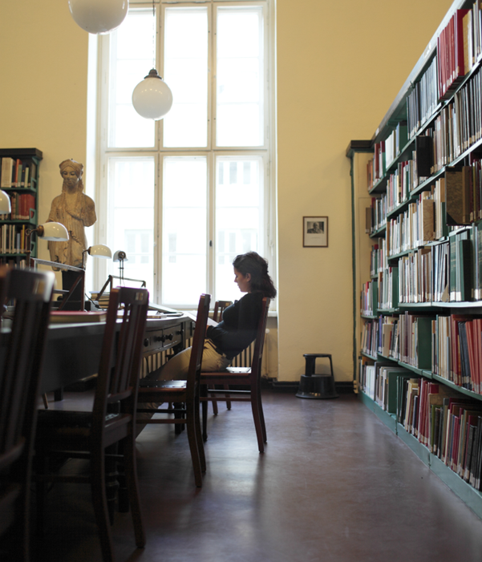
History and Profile
founded in 1831
central institution of the university
provides academic literature for university staff and for more than 35.000 students
open to the public, free of charge
Branch Library for Classical Archaeology
Photo: M. Heyde
Notes:
- the photos in this presentation are from our various branch libraries; here the Branch library of Classical Archaeology

Slide 3
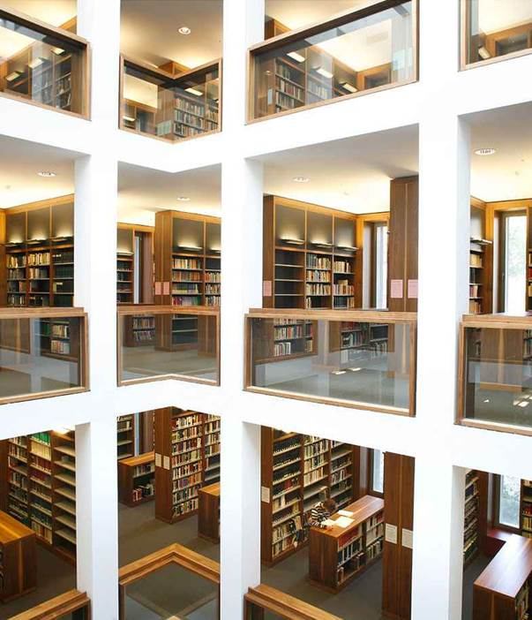
Collections
total collection of about 6 million volumes (books and periodicals)
acquistion budget: about 5 million Euros a year (including third party funds)
an average of 70.000 volumes acquired per year
most collections in open stacks and lendable
books and journals sorted systematically by Regensburger Verbundklassifikation (RVK)
Branch Library for Theology
Photo: E. Fesseler
Notes:
Facts and Numbers about the whole library, which consists of many branches of which the GZ is the biggest one
Germany‘s largest collection of freely accessible books, in open stacks
RVK: systematic arrangement of books; books arranged by topics
picture from the branch library of Theology

Slide 4
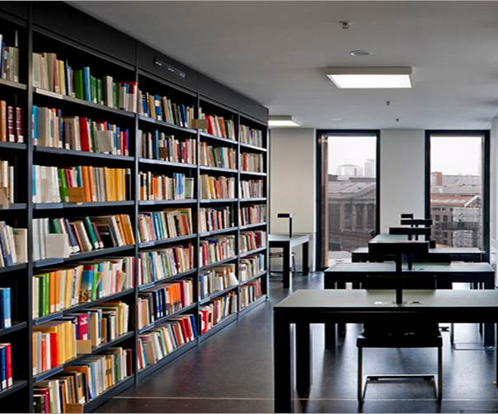
Facts and Figures
2.9 million users / year
104 opening hours / week (Grimm-Zentrum)
2.4 million lendings /year
3.380 work stations
764 PC work stations
38 rooms for group study
72 study carrels
4 parent-child-areas
Note: restrictions due to the current Corona pandemic
Workplaces at Grimm-Zentrum
Photo: Lewandowski
Notes:
- a few facts and figures about the whole institution, picture from GZ

Slide 5
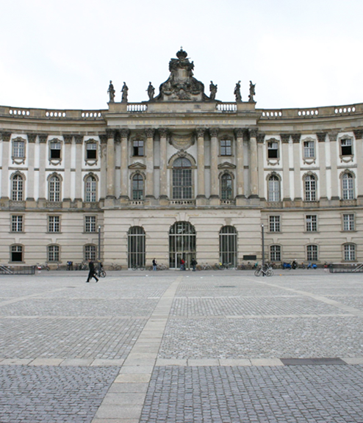
Locations
Jacob-und-Wilhelm-Grimm-Zentrum
Science Branch Library: Erwin-Schrödinger-Zentrum
Branch Library Campus Nord
Law Branch Library
Asian and African Studies Branch Library
Centre for Japanese Language and Culture
Foreign Languages/Literatures Branch Library / Centre for British Studies (Library)
German Studies Branch Library
Classical Archaeology Branch Library
Musicology Branch Library
Theology Branch Library
University Archive
Branch Library for Law in „Kommode“
Photo: Heike Zappe
Notes:
list of the 12 branch libraries; GZ is the biggest one
most of them are situated in Berlin Mitte
Science Branch Library is in Adlershof, long way to go – depending from where you live in Berlin – but it‘s worth it! very nice library, never overcrowded; nice mixture of new and old architecture

Slide 6
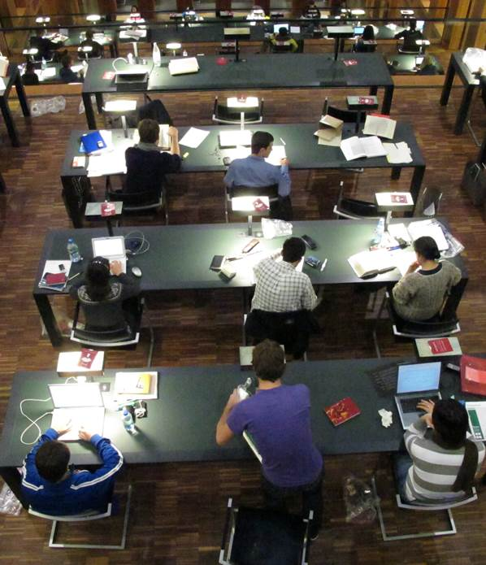
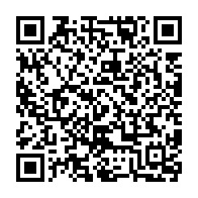
Holdings: Print and electronic
More than 6 million printed volumes:
about 3.7 million in open stacks
about 64.000 in text book collection
Licensed electronic resources:
e-books: more than 200.000 titles
e-journals: more than 24.000 titles
numerous general and subject related databases
our electronic resources are accessible on site or via remote access (VPN, HU members only)
Research gate for all holdings of the library and more:
  primus.ub.hu-berlin.de
Reading terraces in Grimm-Zentrum
Photo: M. Bulaty
Notes:
numbers relate to the whole UL
more and more electronic ressources; decreasing numbers of printed books

Slide 7
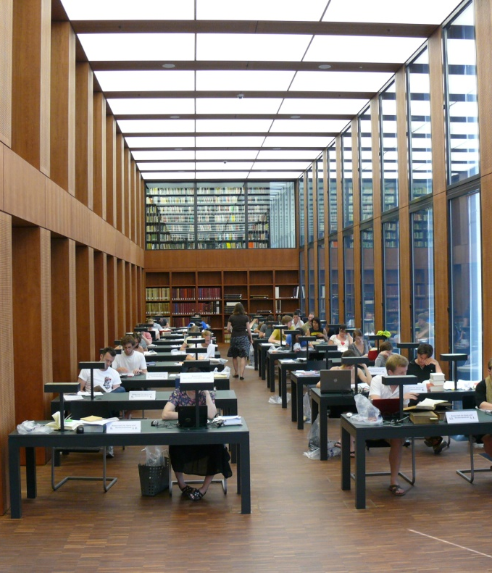
Special Services for PhD candidates 1/6
Study desks, carrels, and book trolleys
20 study desks reserved exclusively for HU staff, scientists, and PhD candidates in the Research Reading Room of the Grimm-Zentrum
study carrels for PhD candidates for one month in several branch libraries
lockable book trolleys for PhD candidates for three months in several branch libraries
Workstations in Grimm-Zentrum; Research Reading Room
Notes:
I will now present to you our special services for HU PhD candidates
we have study carrels in the GZ, Branch Library of Sciences, BL of Foreign Languages, BL of Germanic Languages, BL of Theology
we offer book trolleys in the Science BL, BL of Law, BL of Germanic Studies, BL of Theology, and BL of Foreign Languages; please consult the respective BL for lending details and conditions

Slide 8
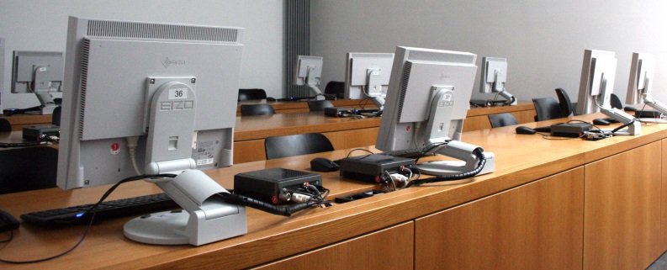
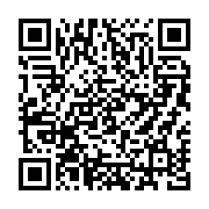
Special Services for PhD candidates 2/6
Support and Training
support of University Library and Computer and Media Service at Grimm-Zentrum and Schrödinger-Zentrum
subject librarians as contact persons for your expert studies
comprehensive range of trainings and workshops (presently webinars, in German only):
https://www.ub.hu-berlin.de/en/learning-how-to-search/tours-of-the-library-and-training
Photo: Anja Herwig
Notes:
support of UL and CMS at the GZ and BL of Natural Science; in the GZ the CMS counter is on the 1st floor, the information desks for the Library are in the foyer and on the ground floor
we offer a wide range of trainings and workshops to improve your research skills, your knowledge on databases, as well as guided tours through the libraries, etc.; all training is in German, but guided tours in English, the next one on 21st February 2020, 9 a.m., one hour
we have specialised subject librarians for each subject; just check our homepage, „subjects“, for their contact details

Slide 9


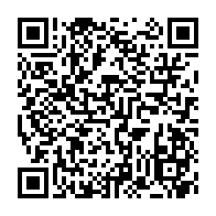
Special Services for PhD candidates 3/6
Reference Management
campus licenses for Citavi and EndNote
regular trainings:
introduction to the programme
reference management and word processing programmes
tips and tricks for using reference management programmes at HU
Notes:
we offer campus licenses for the reference management programmes Citavi and EndNote; please check our homepage for dates of courses: we give an introduction to the programmes, show how to collaborate between reference management and word processing programmes, and how to search for references with these programmes
we also give tricks and tipps for using the programmes at HU (e.g. getting hits from Primus to your reference programme)

Slide 10
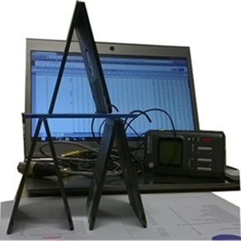
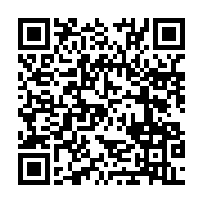
Special Services for PhD candidates 4/6
Research Data Management
Joint service of University Library and CMS
Support and advice
Training and workshops
Website ‘dataman’
  https://www.cms.hu-berlin.de/de/ueberblick/projekte/dataman/
Contact:
researchdata@hu-berlin.de
Photo.: Kerstin Helbig
Notes:
we also offer support in managing your research data: service group of CMS and UL; offer trainings and workshops, e.g. for setting up your own data management plan
check the website ‚dataman‘ for next dates; also available from the UL homepage via „Researching and Publishing“, „Research Data Management“
the team also offers workshops for your working groups exclusively tailored for your needs

Slide 11

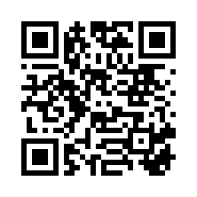
Special Services for PhD candidates 5/6
Open Access
support for researchers at Humboldt-Universität
agreements with several publishers
funding for open access articles and monographs
Contact:
openaccess@ub.hu-berlin.de
https://qr.ub.hu-berlin.de/33191
Lizenzinformation: CC 0
Notes:
HU supports the idea of publishing in Open Access

Slide 12
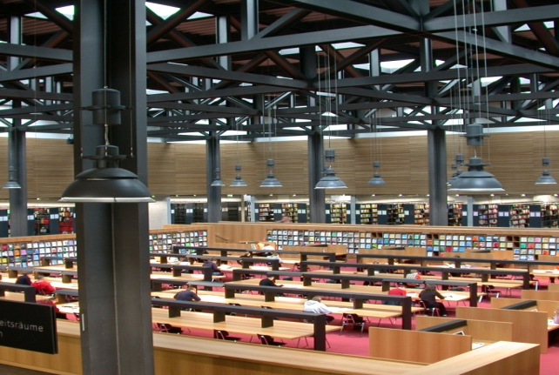
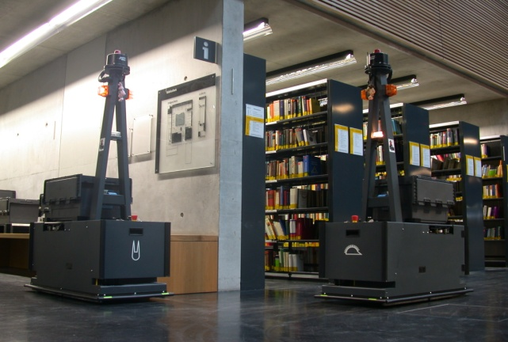
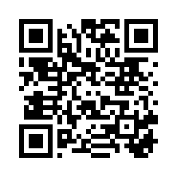
Special Services for PhD candidates 6/6
Publication support
Theses Collection Point
+49 (0)30 / 20 93 – 99233
or – 99231
team-d@ub.hu-berlin.de
support of digital publications by the joint working group of University Library and CMS
edoc@hu-berlin.de
Reading room in Erwin-Schrödinger-Zentrum;
Transportsation system „Hare and hedgehog“ Photos: Anja Herwig
Notes:
support in publishing your thesis and papers

Slide 13
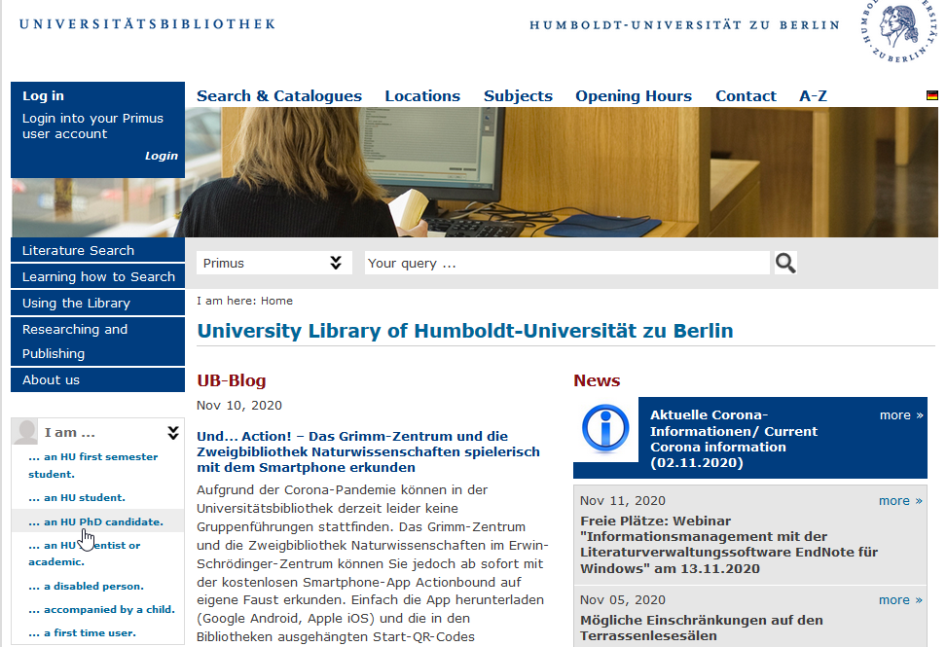
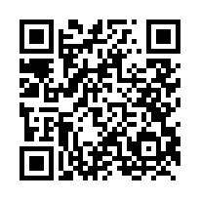
Website information
https://www.ub.hu-berlin.de/en/phd-candidates
Current Corona information: https://www.ub.hu-berlin.de/corona-aktuell
Notes:
support in publishing your thesis and papers
HU supports the idea of publishing Open Access

Slide 14
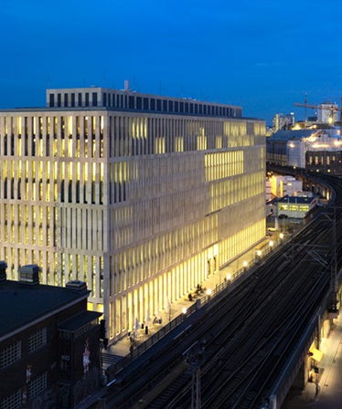
Contact
Humboldt-Universität zu Berlin
University Library
Jacob-und-Wilhelm-Grimm-Zentrum
Geschwister-Scholl-Str. 1/3
D - 10117 Berlin
Germany
info@ub.hu-berlin.de
www.ub.hu-berlin.de
Twitter: @UBHumboldtUni
Grimm-Zentrum by night
Photo: S. Müller

