Slide 1
Erasmus+ for PhD students
Ruben Assmann & Lisa Draser
Humboldt-Universität zu Berlin
ruben.assmann@hu-berlin.de

Slide 2
Erasmus+ Europe
E+ Europe | categories | SMS | SMP | STA | STT | funding | E+ worldwide | countries 2018-20 | countries 2019-2022 | funding | contact
Programme to support ‘mobility’ (≠ scholarship)
Each year 200.000 students going abroad (1-2 semesters)
HU: 1000 Incoming students from 30 countries
HU: 1000 participants outgoings (students/staff/teachers)
ruben.assmann@hu-berlin.de

Slide 3
Erasmus+ categories
E+ Europe | categories | SMS | SMP | STA | STT | funding | E+ worldwide | countries 2018-20 | countries 2019-2022 | funding | contact
Erasmus+
Students |  | Teachers & Staff
Studies | Internships | Staff mobility | Teaching mobiliy
ruben.assmann@hu-berlin.de

Slide 4
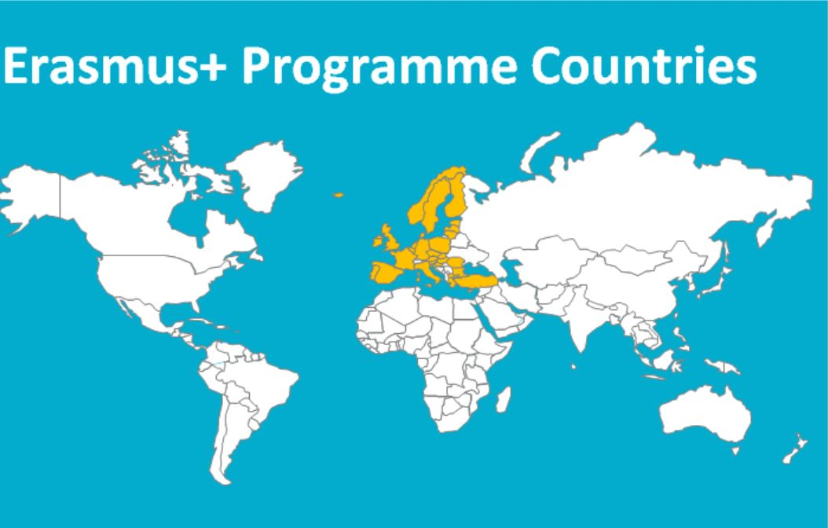
Erasmus+ student mobility (SMS)
E+ Europe | categories | SMS | SMP | STA | STT | funding | E+ worldwide | countries 2018-20 | countries 2019-2022 | funding | contact
300 partner universities & 1000 spots available
Requirements:
Student status (HU enrolment)
Bilateral agreement between HU and partner
Language level: minimum B2 (CEFR/GER)
Funding:
Contingent: 12 months each for Bachelor, Master, PhD
Semester: 4/8 months | Terms: 2,5 / 5 / 7,5 months
€ 330-450 per month (depending on country)
ruben.assmann@hu-berlin.de

Slide 5
Erasmus+ internships (SMP)
E+ Europe | categories | SMS | SMP | STA | STT | funding | E+ worldwide | countries 2018-20 | countries 2019-2022 | funding | contact
Compulsory/voluntary at institute of own choice
Requirements:
Student status (HU enrolment)
Language level: minimum B2 (CEFR/GER)
Full time (minimum 35h/week), Minimum 60 days
Insurances (health, liability, accident)
Funding:
Contingent: 12 months
€ 435-555 per month (depending on country)
ruben.assmann@hu-berlin.de

Slide 6
Erasmus+ teaching mobility (STA)
E+ Europe | categories | SMS | SMP | STA | STT | funding | E+ worldwide | countries 2018-20 | countries 2019-2022 | funding | contact
Teaching at a partner university / collecting of first experiences / networking
Requirements:
Teaching assignment at HU
Bilateral agreement between HU and partner university
Minimum of 8h/week
Funding:
Minimum of 2 days | Maximum of 2 weeks
Fixed allowance for accommodation and travel costs
€ 140-180 per day
ruben.assmann@hu-berlin.de

Slide 7
Erasmus+ staff mobility (STT)
E+ Europe | categories | SMS | SMP | STA | STT | funding | E+ worldwide | countries 2018-20 | countries 2019-2022 | funding | contact
Further education/qualification/training for HU staff
Language courses, job shadowing, workshops, staff weeks,…
Academic Writing, presentation practice, etc.
Requirements:
Employment contract with HU
Workplace-related activity
Funding:
Minimum of 2 days | Maximum of 2 weeks
Fixed allowance for accommodation and travel costs
€ 140-180 per day
ruben.assmann@hu-berlin.de

Slide 8
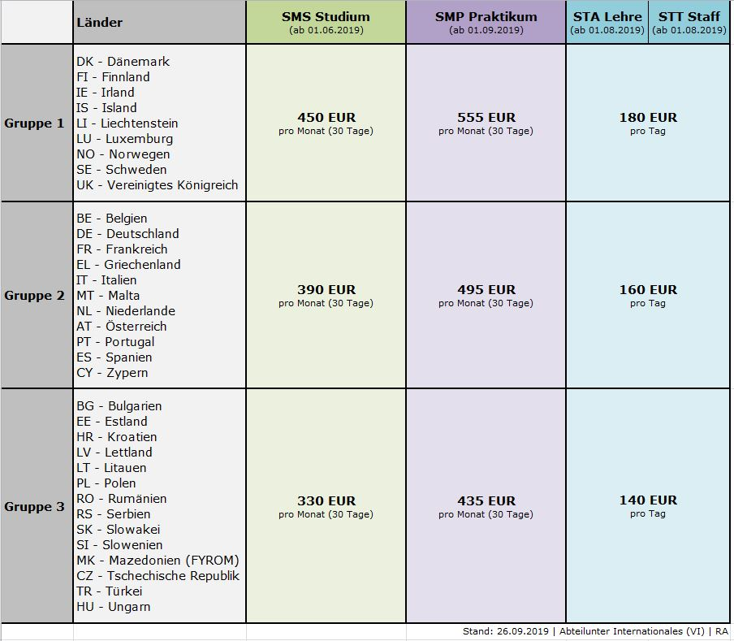
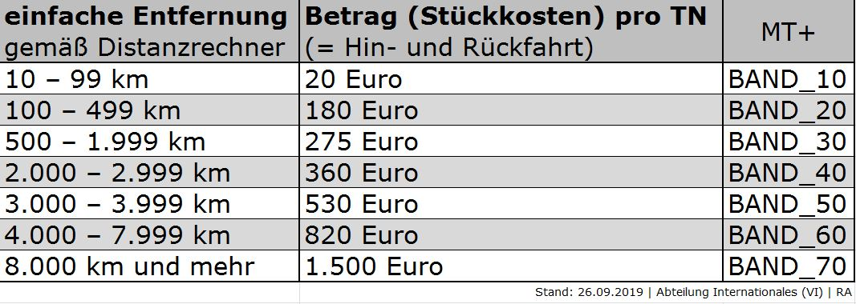
Erasmus+ funding
E+ Europe | categories | SMS | SMP | STA | STT | funding | E+ worldwide | countries 2018-20 | countries 2019-2022 | funding | contact
ruben.assmann@hu-berlin.de

Slide 9
Erasmus+ worldwide
E+ Europe | categories | SMS | SMP | STA | STT | funding | E+ worldwide | countries 2018-20 | countries 2019-2022 | funding | contact
All levels (short cycle, Bachelor, Master, PhD)
All disciplines (students/teachers/staff)
Students: 3-12 months (or academic terms)
Internships: 2-12 months
Staff/Teaching: 5 days to 2 months
ruben.assmann@hu-berlin.de

Slide 10
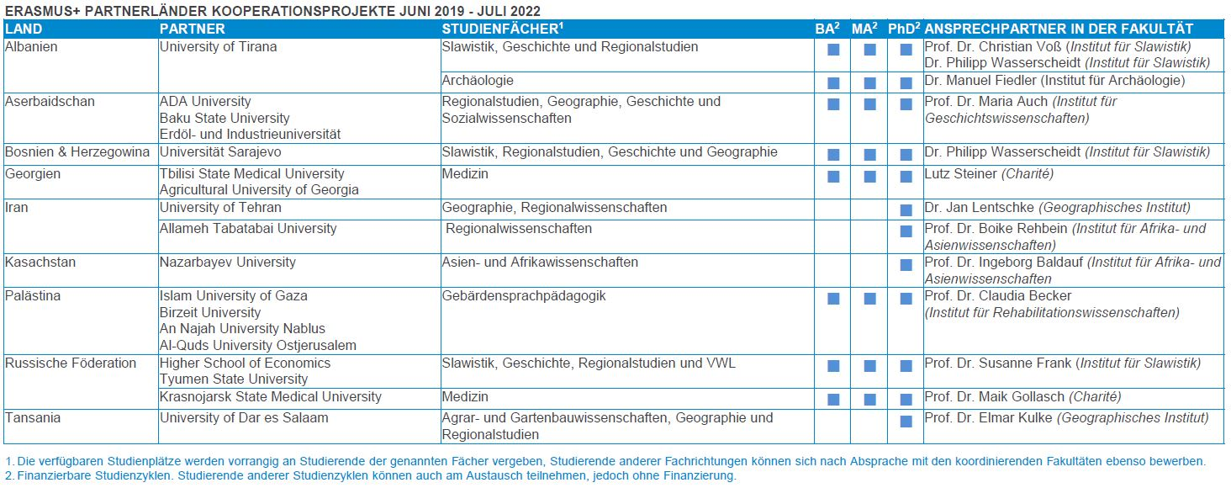
Erasmus+ countries 2019-2022
E+ Europe | categories | SMS | SMP | STA | STT | funding | E+ worldwide | countries 2018-20 | countries 2019-2022 | funding | contact
ruben.assmann@hu-berlin.de

Slide 11
Erasmus+ funding
E+ Europe | categories | SMS | SMP | STA | STT | funding | E+ worldwide | countries 2018-20 | countries 2019-2022 | funding | contact
ruben.assmann@hu-berlin.de

Slide 12
Erasmus+ contact
E+ Europe | categories | SMS | SMP | STA | STT | funding | E+ worldwide | countries 2018-20 | countries 2019-2022 | funding | contact
ruben.assmann@hu-berlin.de

Slide 13
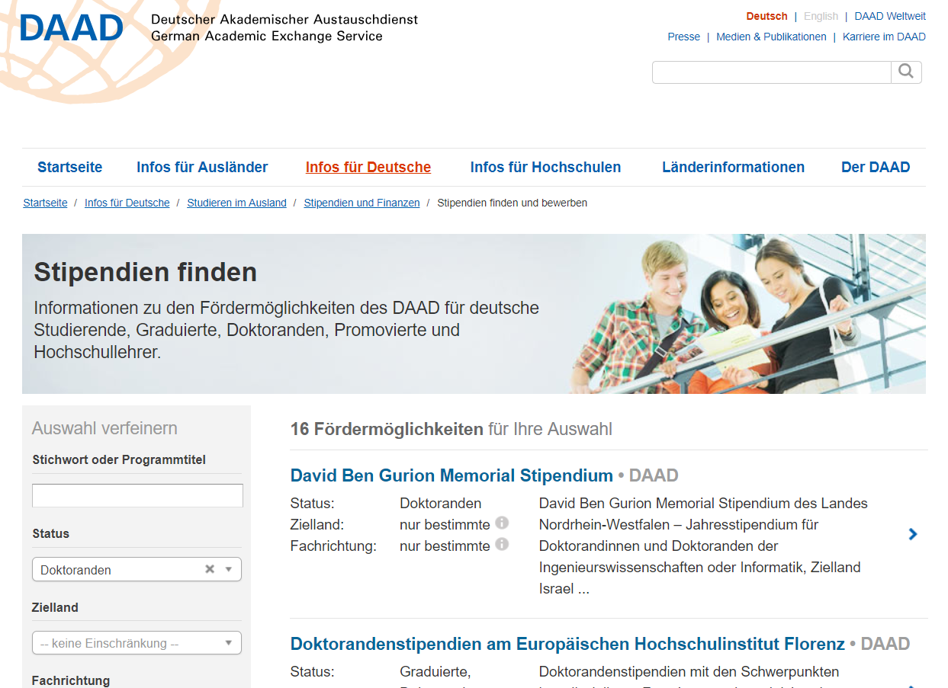
ADDITIONAL INFORMATION
Joint PhD | Humboldt-Universität zu Berlin + King’s College London
Contact: Dr. Christin Bohnke (030 2093-20092 | christin.bohnke@hu-berlin.de)
DAAD database for scholarships
Short term (6 weeks-6 months), Long term (1-2years)
Presentation at conferences (“Kongressreisenprogr.”)
Foundations/Scholarships
Fritz-Thyssen, Gerda-Henkel, Yousef Jameel (HU)

Slide 14
news: Brexit (!)
Erasmus+ funding remains possible until March 2023
Since 2021a visa is necessary for a study period of more than 6 months (student visa) or an internship (T5 visa)
Please allow enough time (at least 2-3 months) for your preperation and application
ruben.assmann@hu-berlin.de

Slide 15
news: Corona (!!)
According to Humboldt-Universität zu Berlin and the Erasmus+ programme: No restrictions for students!
Currently: students abroad for internship/study stay
Generally: health & safety should always be PRIORITY
Keep yourself updated: RKI & Ministry of Foreign Affairs
However only necessary business trips for teachers/staff
ruben.assmann@hu-berlin.de

Slide 16
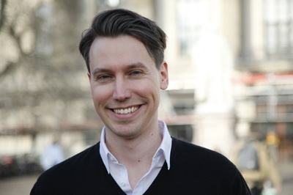
Thank you for your attention!
lisa.draser@hu-berlin.de
ruben.assmann@hu-berlin.de
Erasmus+ Humboldt-Universität zu Berlin

