Slide 2
Sprachenzentrum
Where can you find us?
August-Boeckh-Haus
Dorotheenstraße 65
(next to Hotel Maritim)
3rd floor

Slide 3

www.sprachenzentrum.hu-berlin.de
Notes:
3

Slide 4
Language Courses
English | French | Russian
Italian | Spanish | Czech
Hungarian | Polish | Arabic
Latin | Turkish | Chinese

Slide 5
ENGLISH for GRADUATE STUDENTS and RESEARCHERS
Winter Semester 2013/2014
Courses
91 024 English for Science Graduate Students and Researchers: Writing and Presenting Your Research
91 025 English for Graduate Students: Strategies for Presenting and Writing

Slide 6
91 026 English for Graduate Students: Writing for Research
91 027 English for Graduate Students: Presenting Research in Your Discipline
91 028 English for Graduate Students: Teaching in English
91 029 English for Graduate Students: Abstract Writing and Conference Presentation Skills (21.10.-13.12.13)
91 070 English for Academic Purposes: Writing Essays and Critical Reviews

Slide 7
Online booking via www.sprachenzentrum.hu-berlin.de > Kursangebot > Englisch
http://www.sprachenzentrum.hu-berlin.de/studium_und_lehre/kursangebot
http://www.sprachenzentrum.hu-berlin.de/selbstlernzentrum-en/wissenschaftliches-schreiben-am-sprachenzentrum/kompetenzzentrum-schreiben?set_language=en&cl=en

Slide 8
Workshops
Writing the Introduction to Research Papers in the Natural Sciences
Monday, 4 November 2013 16-19, RUD 26, 1.308 (Adlershof Campus)
Writing the Introduction in the Social Sciences and Humanities
Tuesday, 12 November 2013 16 - 19, DOR 65, 2.45
What is Good Academic Writing in your Field?
Tuesday, 3 December 2013, 16 – 19, DOR 65, 2.45

Slide 9
Writing up your Results and Methods in your Research Paper and Dissertation
Monday, 9 December 2013, 16 – 19, RUD 26, 1.308 (Adlershof Campus)
Publishing your Research Article: The Publishing Process
Monday, 16 December 2013, 16 – 19, RUD 26, 1.308 (Adlershof Campus)
First Impressions and Introductions in Academic Presentations
Monday, 20 January2013, 16 – 19, RUD 26, 1.308 (Adlershof Campus)

Slide 10
Online booking via www.sprachenzentrum.hu-berlin.de > Kursangebot > Englisch > Workshops
http://anmeldung.sprachenzentrum.hu-berlin.de/sprachen/S/sprache0_85.html

Slide 11
91 080: Individual Tutoring Service
The tutoring service is for all students who need individual advice and support in their writing. Presently there are 8 one-half hour slots:
Mi 12-14, DOR 65, Mediothek
Fr 10-12, DOR 65, Mediothek
To sign up for an initial appointment, please e-mail jeffrey.verhey@spz.hu-berlin.de

Slide 12
Writers‘ Groups
Quite simply, a writers group is composed of graduate students who get together regularly to read and discuss each other‘s writing in a structured environment.
If you are interested in joing such a group (or starting such a group), please contact
Jeffrey.verhey@ spz.hu-berlin.de

Slide 13
English Online Writing Lab
If you are confused about the reader’s expectations in regard to good writing or to the format of a research paper in your discipline, the Language Center at Humboldt University has a website to help you. The English Online Writing Lab is an open access virtual library in Moodle, with links to answers to most of your writing questions

Slide 14
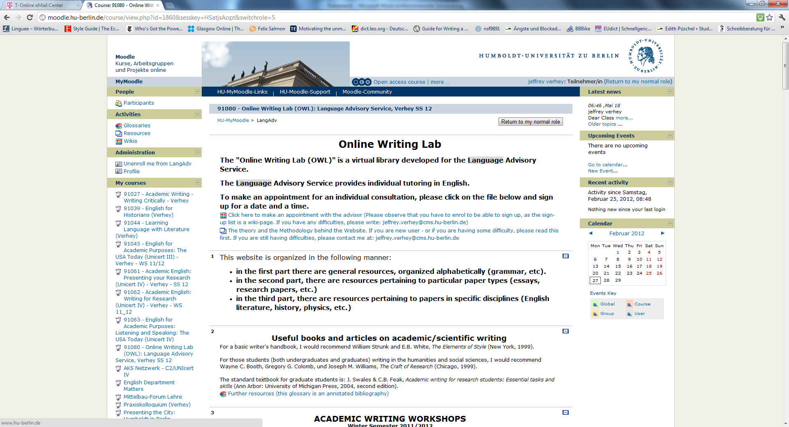
http://moodle.hu-berlin.de/course/view.php?id=35645

Slide 15
Open to suggestions
a journal reading club
?

Slide 16
German as a Foreign Language
  Preperation Courses
  Level A1 and A2
  Preperation Courses
  for Students of all Faculties
  Level B1 to C2
  Preperation Courses
  for Students of German Studies
  Level C1 and C2

Slide 17
Special courses in German for Graduate Students
3 courses for beginners:
  A1.1, A1.2 und A2.1
  Tuesdays and Thursdays from 18-20
One course (C1) for graduate students who are writing their Ph.D. in German
  Monday, 10-14

Slide 18
Online-Registration
Surname, Name, Date of Birth, Origin, Faculty, E-Mail-Address, Matriculation Number
Please do a placement test before you register:
www.sprachenzentrum.hu-berlin.de/studium_und_lehre/einstufungstests-online
You will be placed according to your result.

Slide 19
Counselling
German as a Foreign Language
Office Hours during Semester:
Ms. Dr. Bielagk DOR 65, 3.42
Wed 12:00 – 14:00
Registry DOR 65, 3.41
Mo - Thu 09.30 - 12.00 am; 02.00 - 04.00 pm

Slide 20
Costs
10 Euro per hour per Semester
for example 2 hours per week
= 20 Euro per Semester

Slide 21
ECTS
You will receive ECTS-Points for Language Courses (max. 8)
4 hrs = 5 points
2 hrs = 3 points

Slide 22
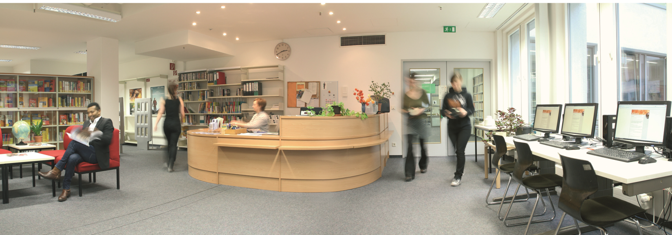
Service
Mediothek (152 languages, ca. 33.000 films and videos,etc.)
Dr. Elke Rößler - ZE Sprachenzentrum

Slide 23
Further Information
http://www.sprachenzentrum.hu-berlin.de
Classes start on
October 21, 2013
Last day: 14.02.2014

